Slide 1
Synchronous & Asynchronous Data Transfer Schemes

Slide 2
What is Transmission?
It is a mechanism of transferring data between two devices connected using a network
Serial Data Transmission
Parallel Data Transmission
Both Synchronous and Asynchronous Transmission are the type of serial data transmission in which data is transmitted between sender and receiver based on the clock pulse used for synchronization.

Slide 3
Serial & Parallel Data Transmission
In serial data transmission – transmitting the data/information bit after bit (only one bit goes through in a particular moment)
In parallel data transmission – transmitting a number of bits at once from one computer to the second computer

Slide 4
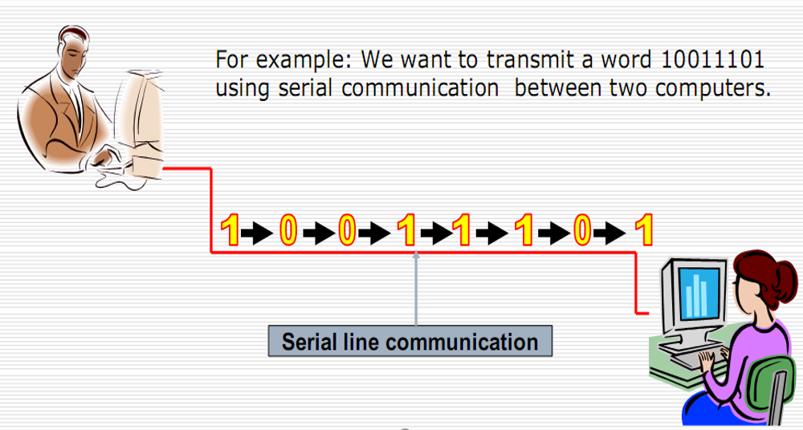
Example for Serial Data Transmission

Slide 5
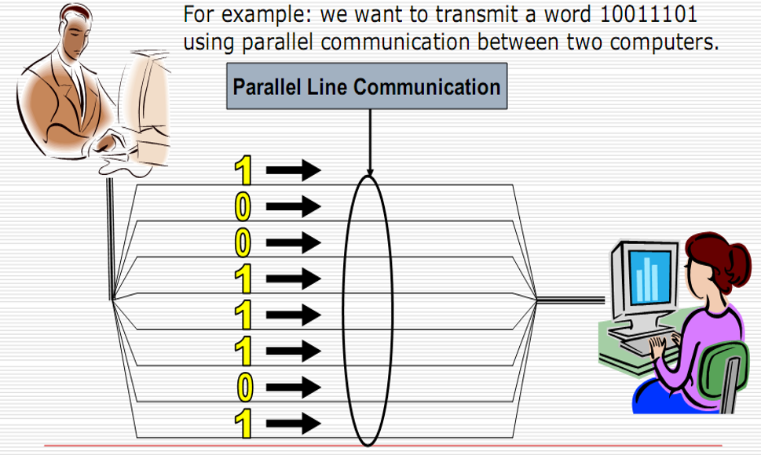
Example for Parallel Data Transmission

Slide 6
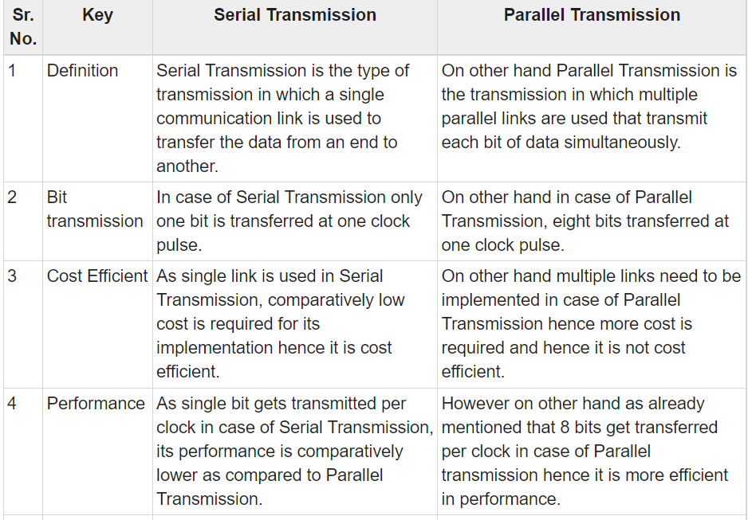

Slide 7
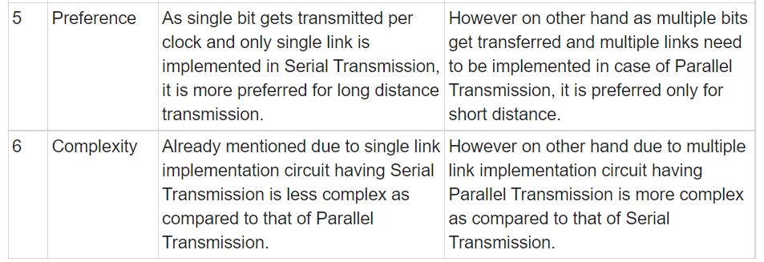

Slide 8
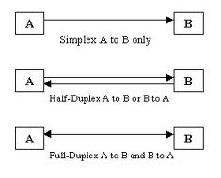

Slide 9
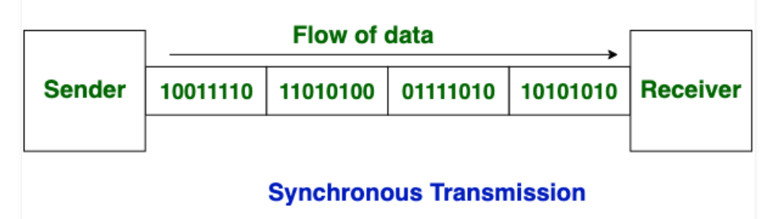
Synchronous Data Transfer
In Synchronous Transmission,
Data is sent in form of blocks or frames
This transmission is the full duplex type
Between sender and receiver the synchronization is compulsory
There is no gap present between data
More efficient and more reliable than asynchronous transmission to transfer the large amount of data.

Slide 10
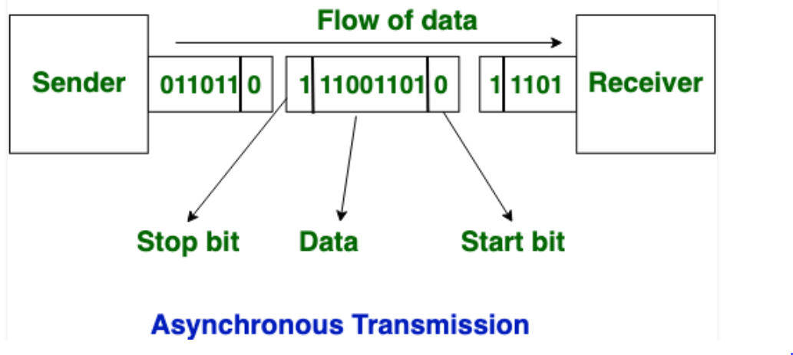
Asynchronous Data Transfer
In Asynchronous Transmission,
Data is sent in form of byte or character.
This transmission is the half duplex type transmission.
Start bits and Stop bits are added with data.
Does not require synchronization.

Slide 11
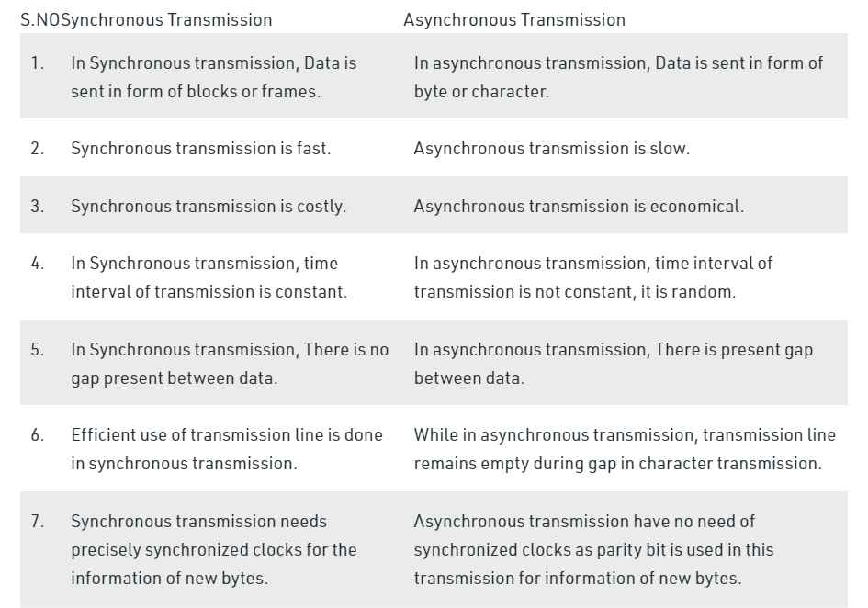

Slide 12
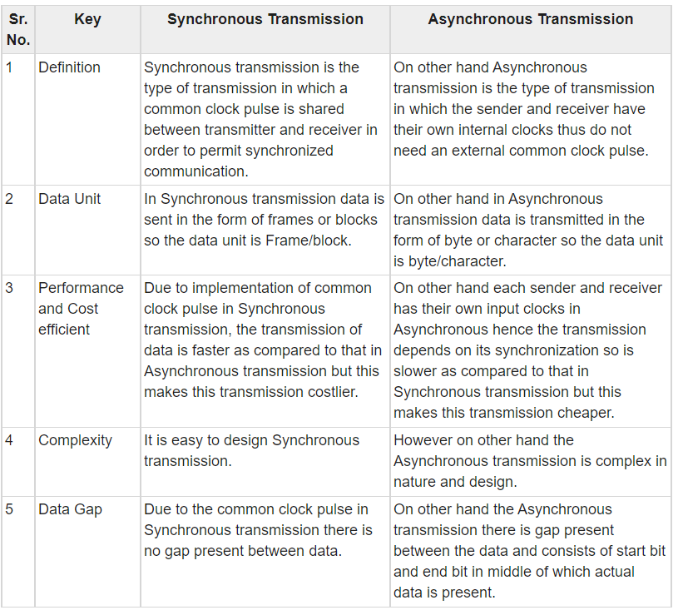

Slide 13
How Synchronous Transmission works?
Separate clocking lines used when the distance between the data terminal equipment (DTE) and data communications equipment (DCE) is short.
This method uses a clocking electrical system at both transmitting and receiving stations. This ensures that the communication process is synchronized.
Devices that communicate with each other Synchronously use either separate clocking channels.
How Asynchronous Transmission works?
Asynchronous communication is eased by two bits, which is known as start bit as ‘0’ and stop bit as ‘1.’
You need to send ‘0’ bit to start the communication & ‘1’ bit to stop the Transmission.
There is a time delay between the communication of two bytes.
The transmitter and receiver may be function at different clock frequencies.

Slide 14
Advantages of Synchronous Transmission
It helps you to transfer a large amount of data.
It offers real-time communication between connected devices.
Each byte is transmitted without a gap between the next byte.
It also reduces time timing errors.
Advantages of Asynchronous Transmission
This is a highly flexible method of data transmission.
Synchronization between the receiver and transmitter is unnecessary.
It helps you to transmit signals from the sources which have different bit rates.
The Transmission can resume as soon as the data byte transmission is available.
This mode of Transmission is easy for implementation.

Slide 15
Disadvantages of Asynchronous Transmission
Additional bits called start and stop bits are required to be used.
Timing error may take place as it is difficult to determine synchronicity.
Slower transmission rate.
May create false recognition of these bits because of noise on the channel.
Disadvantages of Synchronous Transmission
The accuracy of the received data depends on the receiver’s ability to count the received bits accurately.
The transmitter and receiver need to operate simultaneously with the same clock frequency.

Slide 16
Thank You

